Slide 1
物聯網框架標準
廖冠雄 助理教授
義守大學 資訊工程學系
e-mail：ghliaw@isu.edu.tw

Slide 2
大綱
前言
Service Framework
Architectural Framework

Slide 3
Requirements for IoT Architecture
Interoperability
In the way in which software interacts with physical resources
Decouple IoT devices from the software that manages them
Discovery, Management and Reporting, Security, Authorization
Scalability
Large number of devices, users, interactions, connections
Scale-less interaction

Slide 4
Requirements for IoT Architecture
Technology Reuse and Modularity
Software, networks, protocols, data models
Across vendors in a vertical application segment
Across diverse vertical application segments
Low Barrier to Innovation
Anyone can participate and innovate

Slide 5
IoT Service Frameworks
The goal – providing same qualities as web services to IoT
In the context of the Internet and the WWW
Any Web Browser works with any web service, more or less
Regardless of wire protocols used in the network
Regardless of the data models and content types
Across vertical application segments
The WWW scales to planetary size
Low barrier to Innovation

Slide 6
IoT Service Frameworks
Internet and WWW Design Patterns
Narrow Waist, endpoint oriented
Innovation happens at the endpoints, enabled by common, openly available network protocols (the narrow waist)
Layered Protocols
Common set of IP protocols (TCP, UDP) abstract the lower communication layers
Common Application Protocols (HTTP, REST) abstract resources

Slide 7
IoT Service Frameworks
Internet and WWW Design Patterns
Uniform Addressing
URIs and Hyperlinks point to resources
IP Addresses, DNS names are globally unique
Stateless Interaction
Client-Server pattern
Hypermedia As The Engine Of Application State

Slide 8
IoT Service Frameworks
How Does it Apply to IoT?
Internet Protocol (IP) on Constrained Devices
Machine to Machine (M2M) Application Protocols
Standard Object Models and Data Models
Hypermedia for Machine APIs

Slide 9
IoT Architectural Frameworks
Enabling cross-domain interaction and platform unification
system compatibility
interoperability
functional exchangeability
Covering the architectural needs of the various IoT Application Domains

Slide 10
In this course, we briefly intro …
Service Frameworks
Allseen AllJoyn
OIC Core Framework
OMA LWM2M
Thread
Architectural Frameworks
oneM2M
ETSI M2M
IEEE P2413

Slide 11
Allseen AllJoyn (1)
Allseen Alliance
Enable industry standard interoperability between products and brands with an open source framework for IoT
Main members
Qualcomm, Microsoft, Philips, LG, …

Slide 12
Allseen AllJoyn (2)
What is the AllJoyn Framework?
An open source API framework for the Internet of Everything
A way devices and applications publish APIs over a network in a standard way
the “things” on the network expose to other “things”
provides application discovery and fine-grained discovery of the APIs supported by applications

Slide 13
Allseen AllJoyn (3)
High-Level System Architecture
AllJoyn Bus is composed of two types of nodes:
AllJoyn Router (R)
Applications (App)
App can only connect to R
App can contain R
R can connect to other R
The AllJoyn framework can be thought of as a
mesh of stars

Slide 14




















Ad Hoc Bus Formation: Discover
Device
Client App
Find interface org.allseen.media. audio
Implement interfaces org.allseen.media.audio org.allseen.media.video
…
Device
Eureka!
Service App Router
Router
Interface descriptions contained in About message
▪▪ Services advertise, and Clients find, About messages
▪▪ Connect to advertisers supporting desired interfaces
Actual discovery mechanism is transport-dependent:
▪▪ On Wi-Fi, PLC, Ethernet: lightweight IP multicast protocol
▪▪ On Wi-Fi Direct: would use pre-association discovery

Slide 15








Ad Hoc Bus Formation: Session Creation
Device
Connect to
org.allseen.media. audio
Device
Client App
Peer Session
Service
Router ^{App}
AllJoyn Distributed Bus _{Router}
Session creation will cause AllJoyn Routers to connect and extend the bus
▪▪ Once connected, buses merge and have a single shared namespace
▪▪ Peers can discover when other peers join or leave the bus
▪▪ Peers can interact via their APIs
▪▪ Session reference counting keeps device-to-device connections alive
▪▪ Multicast events can be sent to all peers in the session

Slide 16

AllJoyn Software Framework: High-level architecture
A comprehensive software framework lets devices and applications communicate

Slide 17
Two Versions of the AllJoyn Framework To Choose

Slide 18































Introduction to OIC – Optimized for IoT
RESTful Architecture
Common Platform
Certification Program
CoAP for Constrained Devices
Full Stack Interop. Test

Slide 19
OIC Key Concepts (1/2)
Open-source Implementation – Iotivity project (https://www.iotivity.org/)
Free IPR License (Code: Apache 2.0 & Spec: RAND-Z)
License covers both code, standards and related IPR
License applies to members and affiliates of members
Dedicated and optimized protocols for IoT (e.g. CoAP)
Specific considerations for constrained devices
Fully compliant towards RESTful architecture
Built-in discovery and subscription mechanisms
Standards and Open Source to allow flexibility creating solutions
Able to address all types of devices, form-factors, companies and markets with the widest possibility of options
Open Source is just one implementation to solve a problem

Slide 20
OIC Key Concepts (2/2)
Full stack definition for maximum interoperability
Connectivity, Platform and Vertical Services defined
License applies to members and affiliates of members
Certification and Logo program
Guarantees all devices work together
Consistent user awareness for interoperability

Slide 21



































































































Sample of Current Members
Diamond
Platinum
Gold

Slide 22
Objectives
Core Framework Specification Scope
Specifies the technical specification(s) comprising of the core architectural framework, messaging, interfaces and protocols based on approved use-case scenarios
Enables the development of vertical profiles (e.g. Smart Home) on top of the core
Architect a core framework that is scalable from resource constrained devices to resource rich devices
Evaluate technical specification(s) for maximum testability and interoperability
Ensure alignment with OIC open source releases

Slide 23
OIC Roles
OIC Client
i) Initiate an transaction (send a request) & ii) access an OIC Server to get a service
OIC Server
i) host OIC Resource & ii) send a response & provide service

Slide 24

OIC Architecture
OIC adopted RESTful Architecture
Current OIC Architecture defines 2 logical roles that devices can take
OIC Server : A logical entity that exposes hosted resources
OIC Client : A logical entity that accesses resources on an OIC Server
OIC
Client
OIC
Server
R
Model 1

Slide 25







Organization of an OIC Device
OIC Device concept
Resource URI: /oic/p
rt: oic.wk.p
if: oic.if.r
n: homePlatform policy: bm:11
pi: at1908 mnmn: Samsung
/oic/p
/oic/res
/oic/res
/oic/d
/oic/d
/oic/mnt
/oic/prs
OIC Device 1
OIC Device 2
Physical Device e.g. light bulb
Mandatory
Optional

Slide 26
Device example: light device (oic.d.light)

Slide 27
OIC Spec Features – Core Framework Spec
① Discovery: Common method for device discovery (IETF CoRE)
② Messaging: Constrained device support as default (IETF CoAP) as well as protocol translation via intermediaries
③ Common Resource Model: Real world entities defined as data models (resources)\
④ CRUDN: Simple Request/Response mechanism with Create, Retrieve, Update, Delete and Notify commands
⑤ Device Management: Network connection settings and remote monitoring/reset/reboot functions
⑥ ID & Addressing: OIC IDs and addressing for OIC entities (Devices, Clients, Servers, Resources)
⑦ Security: Basic security for network, access control based on resources, key management etc

Slide 28
OIC Core Framework Basic Operation

Slide 29
Protocol Stack
30

Slide 30
OMA LWM2M
OMA – Open Mobile Alliance
LWM2M – Light-Weight M2M
to serve the IoT market with a focus on lightweight nature

Slide 31
Features

Slide 32
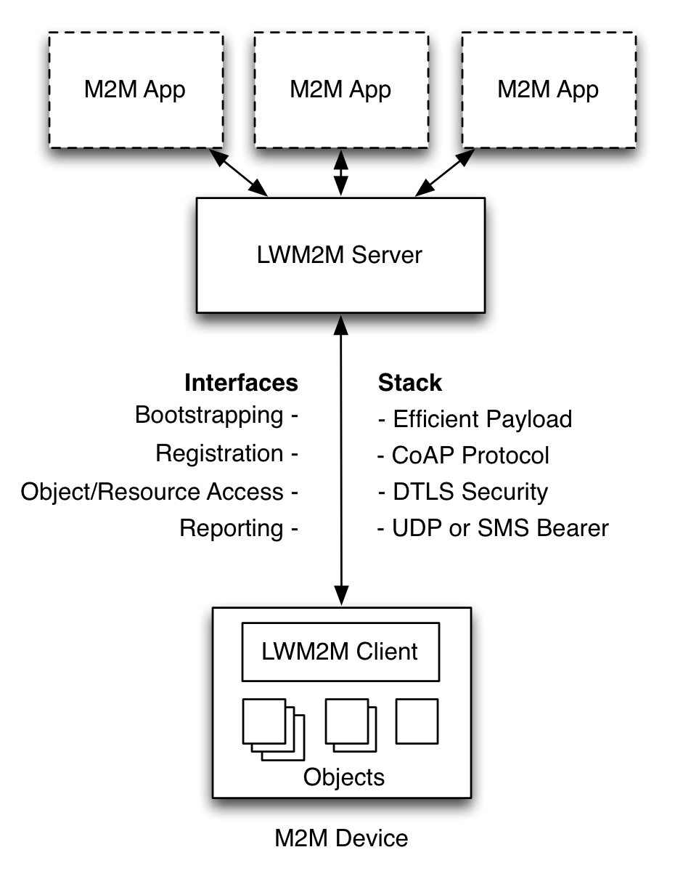
OMA LWM2M Architecture
M2M Applications
Application abstraction through REST API
Resource Discovery and Linking
LWM2M Server
Reuses IETF technologies, such as the CoAP protocol, DTLS, Resource Directory.
Deployable on gateways and in the cloud
LWM2M Clients are Devices
Device abstraction through CoAP
LWM2M Clients are CoAP Servers
Any IP network connection

Slide 33

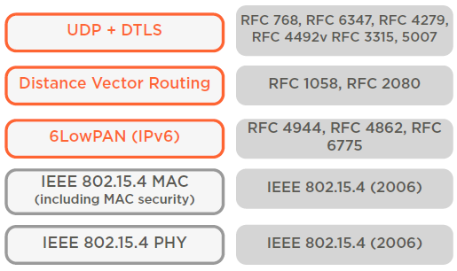
What is Thread?
A secure, wireless mesh networking protocol that:
Supports IPv6 addresses and simple IP bridging
Is built upon a foundation of existing standards
Is optimized for low-power / battery-backed operation
Is intended for control and automation (250kbps)
Can support networks of 250 nodes or greater
Supports low latency (less than 100 milliseconds)
Offers simplified security and commissioning
Runs on existing 802.15.4 wireless SoCs
http://www.threadgroup.org/

Slide 34
Connected Home – Networking Requirements
Direct addressability of devices – within the HAN and from smart phones or tablets
•
Simplified forming and joining of network, limit special devices or customer knowledge of concepts like coordinator vs. router vs. end device
Scalable to 200-300 devices in a home – with sufficient routers to provide coverage but remainder can be end devices
Latency less than 100 milliseconds for typical interactions (user interaction concern)
•
•
Allow the use of multiple gateways
Seamless connectivity to user interaction on device of choice in the home (dedicated display, smart phone, tablet, etc.)
Battery operated devices with years of expected life – door locks, security sensors etc.

Slide 35
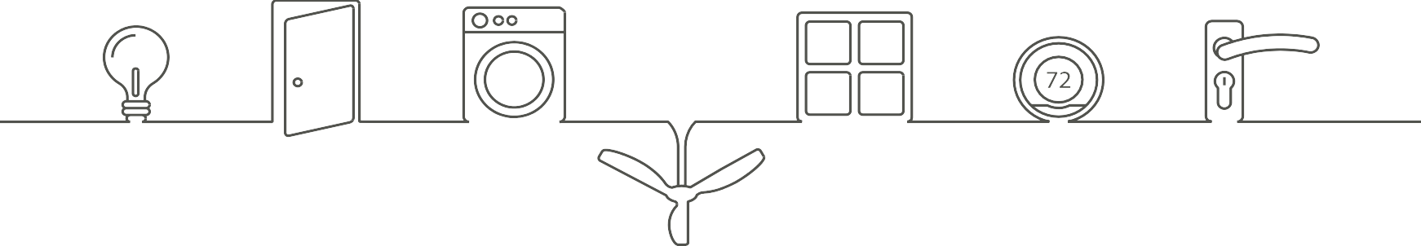






Target Devices
•
Normally Powered
•
Powered or Battery
Normally Battery
Gateway
Lighting
Appliances
Smart Meter
Garage door opener
HVAC equipment
Smart Plugs
Fans
Thermostat
Light switches
Smoke detectors
In home display
Shades or blinds
Door bell
Glass break sensors
Robots/cleaners
Door sensors
Window sensors
Motion sensors
Door locks
Radiator valves
Body sensors

Slide 36
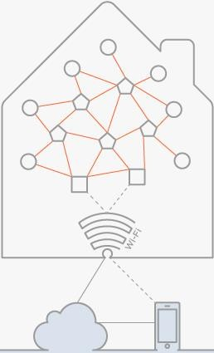
System Messaging Model
Expect device to device communication within HAN for operations in the home
Thread
HAN
Border Router forwards data to cloud
Also provides WiFi connectivity to phone or tablet in the home
Cloud connectivity for control when not at home
When within the home, phone or tablet must go direct to gateway to reduce latency
Has to be seamless to consumer using device

Slide 37














Key Features Overview
IP-based:
Thread
Standard
Simplified bridging to other IP networks
Flexible Network:
Application Layer
Simplified device types
UDP + DTLS
RFC 768, RFC 6347, RFC
4279, RFC 4492, RFC 3315,
RFC 5007
Robust:
Distance Vector Routing
RFC 1058, RFC 2080
No single point of failure
IPv6
RFC 4944, RFC 4862, RFC
6282, RFC 6775
6LowPAN
Secure:
IEEE 802.15.4 MAC
(including MAC security)
IEEE 802.15.4 (2006)
Simple security and commissioning
Physical Radio (PHY)
Low Power Operation:
Support for sleeping devices

Slide 38
oneM2M – The Common Service Layer

Slide 39
oneM2M – Common Service Functions

Slide 40
oneM2M – Technical Reports

Slide 41
oneM2M – Technical Specifications

Slide 42
oneM2M – Use Cases & Requirements

Slide 43
oneM2M - Architecture

Slide 44
oneM2M - Architecture

Slide 45
ETSI M2M - High Level Architecture

Slide 46
ETSI M2M - Architecture

Slide 47
ETSI M2M - Example

Slide 48
ETSI M2M – High Level Deployment

Slide 49
IEEE P2413
Focus to integrate market needs with the developing IoT technology landscape
Define an Architectural Framework for the IoT
descriptions of various IoT domains
definitions of IoT domain abstractions
identification of commonalities between different IoT domains

Slide 50
IEEE P2413
The Architectural Framework for IoT provides
reference model
defines relationships among various IoT domains
reference architecture
builds upon the reference model
defines basic architectural building blocks and their ability to be integrated into multi-tiered systems
addresses how to document and mitigate architecture divergence.

Slide 51





IEEE P2413 Definitions
The Group accepted the definition of the “Thing”:
Notes:
Things, Apps, and Services can be integrated into what would be abstracted as a “Thing”
Information exchange could be “horizontal” (subscribe/ publish as an example) or vertical, or both
Properties could be real or virtual
Apps & Services
Security
Function/Method
The “Thing”
Properties
Information Exchange

Slide 52
IEEE P2413 Levels of abstractions
Universal Thing Description
Who am I Who makes me What can I do
Where do you go to get more info Who is asking
What language do I talk

Slide 53
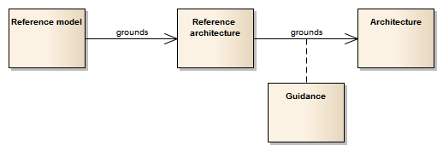
IEEE P2413 Structure

Slide 54
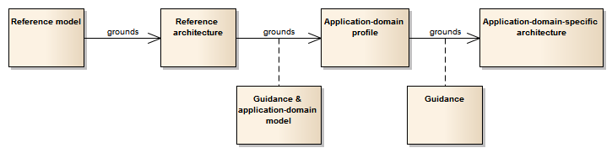
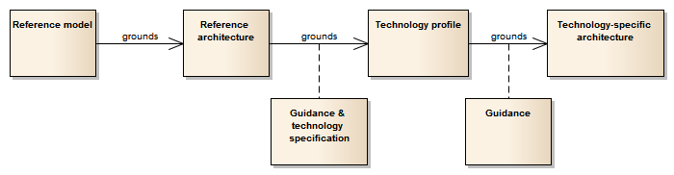
IEEE P2413 Potential Profiles

